Slide 1
Introduction to Zoning & Subdivision Regulations Fundamentals including Statutory and Judicial Authority
Craig Farmer, FAICP
Director of Development and Neighborhood Services
City of Weatherford, Texas
cfarmer@weatherfordtx.gov
Based on A Guide to Urban Planning in Texas Communities published by the Texas Chapter of American Planning Association

Slide 3
ZONING REGULATIONS

Slide 4
Be Prepared . . .

Slide 5
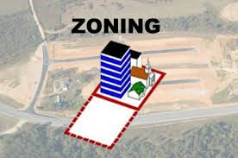
Zoning – What Is It?
The division of city or area into districts and prescription and application of different land use regulations in each district. An exercise of the police power that allows cities to regulate the rights of a private individual for the good of the community.

Slide 6
A Brief History of Zoning
Zoning is a valid exercise of the police power to protect the community’s health, safety and welfare.
Village of Euclid v. Amber Realty Co.
272 U.S. 365 (1926)

Slide 7
A Brief History of Zoning
Standard Zoning Enabling Act – 1926
Texas:
Lombardo v. City of Dallas, 124 Tex. 1, 73 S.W. 2d 475 (1934)
All property is held subject to the police power
A proper zoning regulation is not a “taking” for which compensation must be paid
Texas Local Government Code – Chapter 211

Slide 8
Purpose – §211.001
To promote the public health, safety, morals, or general welfare and protecting and preserving places and areas of historical, cultural, or architectural importance and significance.

Slide 9
What Can Cities Regulate – §211.003
Height, number of stories, and size of buildings and other structures
Percentage of a lot that may be occupied
Size of yards, courts, and other open spaces
Population density
Location and use of buildings, other structures, and land for business, industrial, residential or other purposes
In areas of historical, cultural or architectural significance - may regulate construction, reconstruction, alteration or razing of buildings or other structures
Home rule cities may also regulate the bulk of buildings

Slide 10
Districts – § 211.005
City may divide municipality into districts of a number, shape, and size
Regulations must be uniform for each class or kind of building in a district
Regulations may vary from district to district
Regulations must be adopted “with reasonable consideration, among others things, for the character of each district and its peculiar suitability for particular uses with a view of conserving the value of buildings and encouraging the most appropriate use of land in the municipality”
Planned Development Districts
Conditional Use Permit

Slide 11
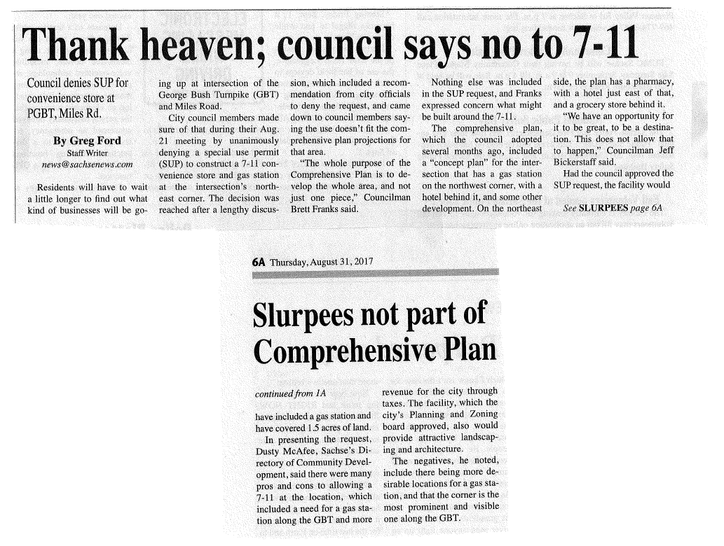
Compliance with Comprehensive Plan?
The State of Texas requires that municipalities zone in accordance with a comprehensive plan.
§211.004 of the Texas Local Govt. Code.

Slide 12
The Comprehensive Plan – §211.004
Zoning regulations must be adopted in accordance with a comprehensive plan and must be designed to (police power elements):
lessen congestion in the streets
secure safety from fire, panic, and other dangers
promote health and general welfare
provide adequate light and air
prevent the overcrowding of land
avoid undue concentration of population
facilitate that adequate provision of transportation, water, sewers, schools, parks, and other public requirements

Slide 13
The Comprehensive Plan – §211.004
Elements of a Comprehensive Plan
Land use plan
Transportation plan
Park and Open Space plan
Housing and Public facilities plan
Written policies and goals

Slide 14
Procedures - §211.006 and 211.007
Notice
Published in the newspaper of general circulation
Mailed notice to property owners within 200 feet
Hearing - Public hearing required
Recommendation - Zoning Commission must make a recommendation prior to the City Council public hearing (in a General Law city, the Council may act as the zoning commission)

Slide 15
Procedures - §211.006 and 211.007
Legislative Action
Generally simple majority vote approves a zoning change
Protest - if property owners of 20% of area within 200 feet of the proposed zoning change file a written protest, Council must vote by super-majority (3/4 of members voting in affirmative) to approve an amendment
Property Owner Protest - If property owners of 20% of the land area covered by the proposed amendment file protest, Council must vote by super-majority (3/4) to approve an amendment

Slide 16
Making a Zoning Decision

Slide 17
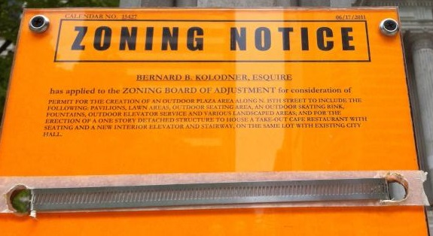
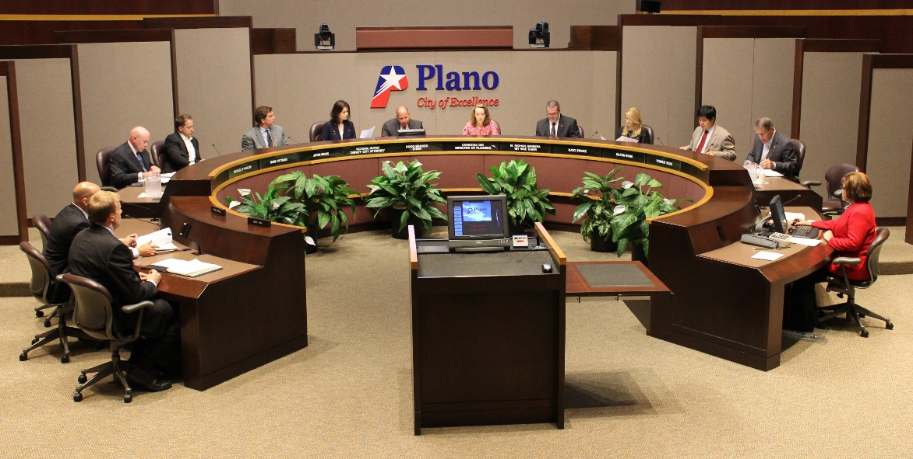
Fourteenth Amendment
14th Amendment provides that states (cities) shall not deprive any person of life, liberty, or property without due process of law; nor deny to any person within its jurisdiction equal protection of the laws.
Due process requires all persons similarly situated be treated similarly (equal protection).
+

Slide 18
Fourteenth Amendment
When does an individual have a property interest?
Chapter 211 of the Texas Local Govt. Code is the Texas Legislature's practical response. If you are the property owner of the property being rezoned or if you own property within 200 feet of the property being rezoned, then you are deemed to have a property interest in the governmental action. (Home-rule cities may provide different rules.)

Slide 19
Fourteenth Amendment
What notice is required?
Again, § 211.007 of the Texas Local Govt. Code establishes that written notice, 10 days prior to the public hearing before the Zoning Commission is deemed to be adequate notice. (Home-rule cities may provide different rules.)
What hearing is required?
See §211.006 and § 211.007 of the Texas Local Govt. Code.

Slide 20
Fifth Amendment
5th Amendment provides that private property shall not be taken for public use without just compensation.
Typically two types of claims for a taking by a municipality. One involves an actual physical invasion of private property, other a diminution in development rights on property by virtue of some regulatory action taken by city.
--
Illustration: City passes ordinance which requires a landowner permit of a very small cable TV connection box and connection by company upon payment to property owner of a nominal fee.
See Loretto v. Teleprompter Manhattan CATV Corp., 458 U.S. 419 (1982).

Slide 21
First Amendment
1st Amendment provides that congress shall make no law respecting an establishment of religion, or prohibiting the free exercise thereof; or abridging the freedom of speech, or of the press; or the right of the people peaceably to assemble, and to petition the Government for a redress of grievances.
&

Slide 22
Factors to Consider in Making a Land Use Decision

Slide 23
Secondary Effects of Proposed Use?
Decisions on zoning applications should be made based on an analysis of impact of proposed use on neighborhood and on city as a whole. Such factors include traffic impacts, noise, light, air, crime, and facilitation of adequate provision of water, sewers, schools, parks and other public requirements. See §211.004 of the Texas Local Govt. Code.

Slide 24
Reasonable Use of the Property?
Any zoning regulation by a municipality must provide a property owner with a reasonable use of the property. Does the proposed regulation allow the property owner a reasonable use of the property?
Photo: Freedom Center of Missouri

Slide 25
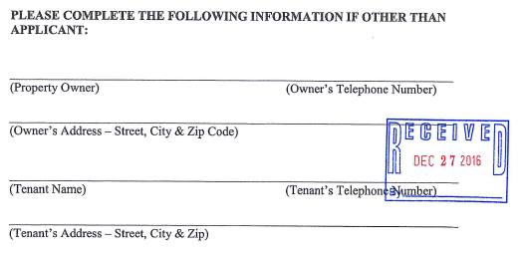
Vested Rights - Ch. 245 of the Texas Local Govt. Code.
§245.002 -- Each regulatory agency shall consider the approval, disapproval, or conditional approval of an application for a permit solely on the basis of any orders, regulations, ordinances, rules, expiration dates, or other properly adopted requirements in effect at the time the original application for the permit is filed.

Slide 26
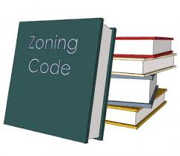
Zoning Ordinance Components Use regulations Districts Procedures Development Standards
Lot area
Setbacks
Lot width
Heights
Dwelling area
Densities
Parking
Landscaping
Open Space
Tree Preservation
Lighting/ Glare
Screening/ Fencing
Urban Design
Environmental issues

Slide 27
Types of Zoning
Standard Districts
Overlay Districts
Special Districts
Specific Use Permits
Form Based Codes
Smart Codes
Lot area
Setbacks
Lot width
Heights
Dwelling area
Densities
Parking

Slide 28
Performance Standards regulations Districts Procedures Development Standards
Environmental constraints
Architectural standards
Cultural amenities
Density bonuses
Phasing
Special Districts
Unique uses
Lot area
Setbacks
Lot width
Heights
Dwelling area
Densities
Parking

Slide 29
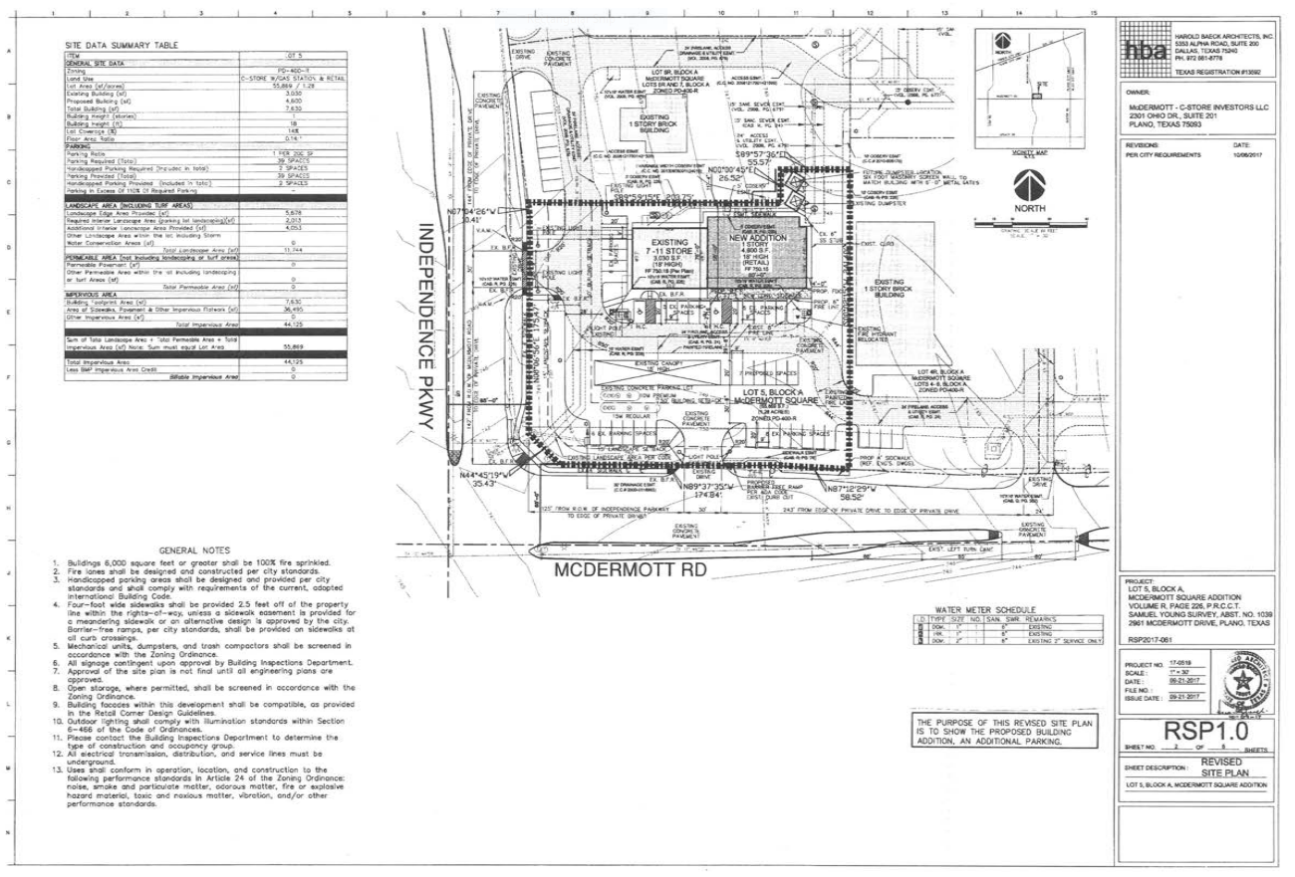
Site Plan Review
Is a site plan is required?
Has a site plan has been approved?
If a site plan has been approved, does the site comply?
If the site does not comply, what is the site plan amendment process?
Does the city have a minor amendment process?
Who has approval authority
- planning and zoning commission, city council, or staff?

Slide 30
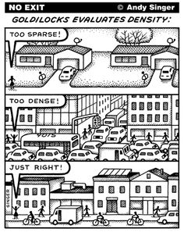
Additional zoning concepts
Form-based codes
Smart codes
Conservation
New Urbanism

Slide 31
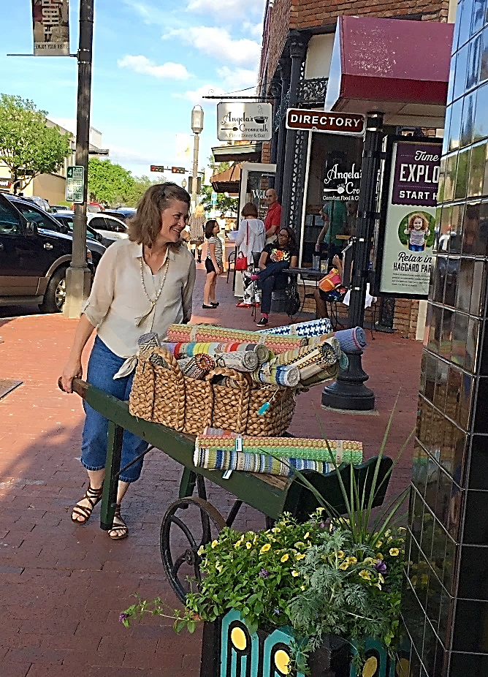
Common Themes
Mixed Use
High Density
Pedestrian orientation
Transit orientation
Connectivity
Conservation/Preservation
Architectural standards
Historical/Cultural/Environmental
Transitions instead of buffers
FLEXIBILITY

Slide 32
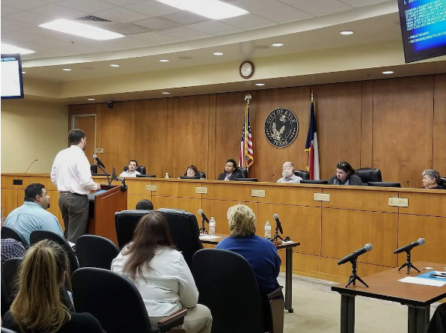
Zoning Commission
Recommending Body under State Law §211.007
Must forward a report to the City Council
(Starlight Williams/Community Impact Newspaper)

Slide 33
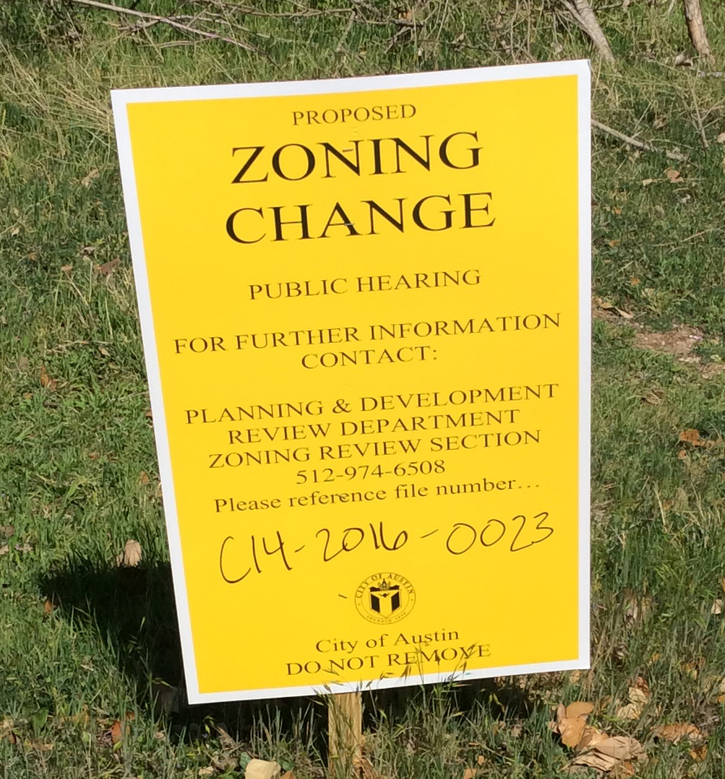
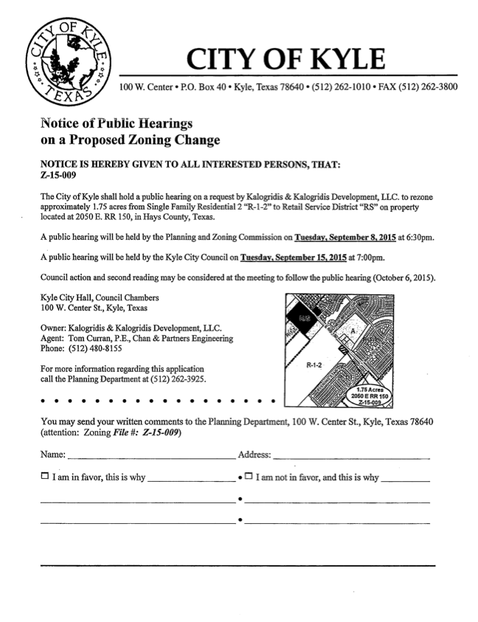
Rezoning Process
Zoning Commission hearing
Notice
City Council hearing
Notice
Report
Timelines vary between Home-Rule and General Law

Slide 34
Rezoning Process
meeting with the city staff
preparing the application
meeting with surrounding property owners and neighborhood associations
filing the application
conducting the zoning commission hearing
addressing any conditions, concerns or questions of the zoning commission including meeting with the neighborhood association, if necessary
presenting the application to city council
confirming adoption of the ordinance

Slide 35
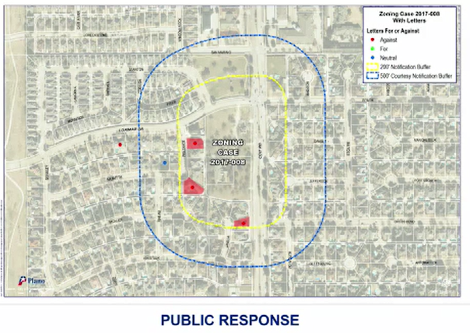
Supermajority Vote
¾ majority required:
Written opposition from the owners of 20% of the property within 200’
Overrule a recommendation of denial, if provided by ordinance

Slide 36
Board of Adjustment
Quasi-judicial
Hear and decide an appeal that alleges error in an order, requirement decision, or determination made by an administrative official in the enforcement of the city’s zoning ordinance
Hear and decide special exceptions
Authorize a variance from the terms of a zoning ordinance
Hear and decide other matters authorized by the city’s zoning ordinance

Slide 37
Board of Adjustment
The concurring vote of 75 percent of the members of the board is necessary to:
Reverse an order, requirement, decision, or determination of an administrative official;
Decide in favor of an applicant on a matter on which the board is required to pass under a zoning ordinance; or
Authorize a variation from the terms of a zoning ordinance.

Slide 38
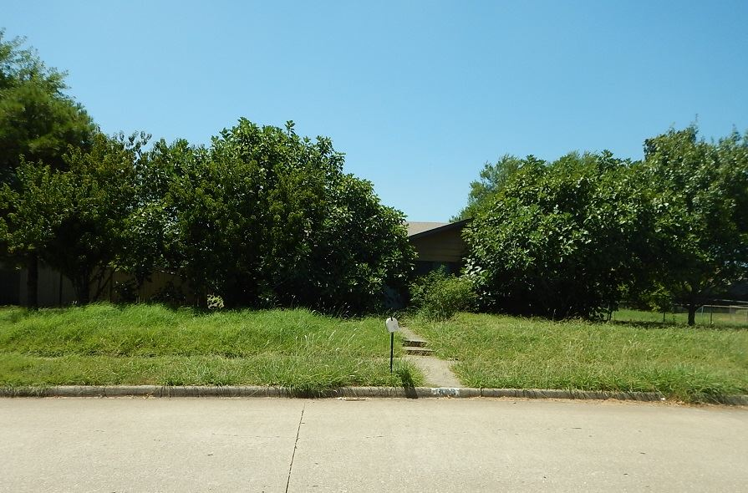
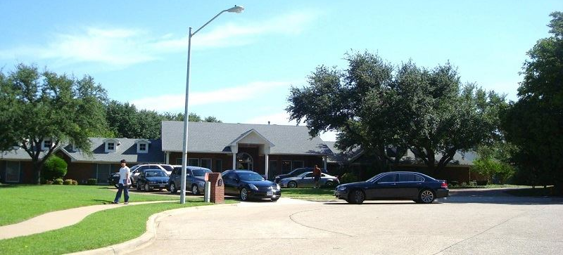
Zoning Enforcement
The City, in addition to other remedies, may institute appropriate action to:
(1) prevent the unlawful erection, construction, reconstruction, alteration, repair, conversion, maintenance, or use;
(2) restrain, correct, or abate the violation;
(3) prevent the occupancy of the building, structure, or land; or
(4) prevent any illegal act, conduct, business, or use on or about the premises.

Slide 39
Limits to a City’s Zoning Authority
Jurisdictional boundary of municipality
Preemption
Specific uses
Churches
Signage
Pawn shops
Federal and State Buildings
Independent School Districts

Slide 40
Challenges
Inverse condemnation, damaging, taking
Substantive due process
Procedural due process
Failure to comply with statutory/ local procedures
Equal protection
Free Exercise
Spot Zoning
Contract Zoning

Slide 41
SUBDIVISION REGULATIONS

Slide 42
Enabling Legislation
Texas Local Government Code
Chapter 211 – Municipal Zoning Authority
Chapter 212 – Municipal Regulation of Subdivisions
Chapter 213 – Municipal Comprehensive Plans

Slide 43
Purpose of Subdivision Regulations
Conversion of raw land into buildable lots
Requirements for public improvements
Standards for land development
Procedures for submittal, review and approval of plats
Shape future development
Determine physical shape and function of community
Lasting impact on community design
Notes:
Subdivision regulations are local ordinances that govern the conversion of raw land into buildable lots.
The ordinance establishes requirements for public improvements, specify standards for land development, and outline procedures for submittal, review and approval of subdivision plats.
Subdivision regulations are instrumental in shaping future development .
No planning device is more important and has a more lasting impact on community design (the physical shape of the city and how it will function) than does subdivision regulation.

Slide 44
Relationship to Comprehensive Plan
An important tool for comprehensive plan implementation
Comprehensive plan provides legal and practical basis for subdivision regulations
Consistency with plan avoids arbitrary or discriminatory regulations
Plan coordinates subdivision layout with other community development
Notes:
Subdivision regulation is one tool for carrying out the recommendations of the comprehensive plan.
The plan is a legal and practical necessity as the basis for subdivision regulation. The plan is evidence that the regulations are not arbitrary or discriminatory. The plan allows the city to have a basis to coordinate subdivision layout with other development in the area.

Slide 45
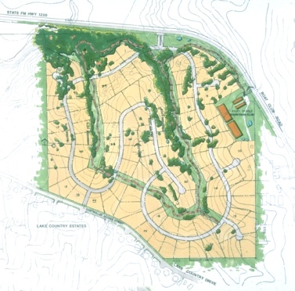
Purposes Served
Creates a legal description
Convenient and accurate plat recordation
Orderly community development
Adequate roads, utilities, drainage, open space, park and school sites
External protection and conservation for surrounding areas
Adequacy/capacity of public facilities

Slide 46
When is a Plat Required?
“The owner of a tract of land located within the limits or in the extraterritorial jurisdiction of a municipality who divides the tract into two or more parts to lay out a subdivision of the tract … must have a plat of the subdivision prepared.”
Section 212.004, Local Government Code

Slide 47
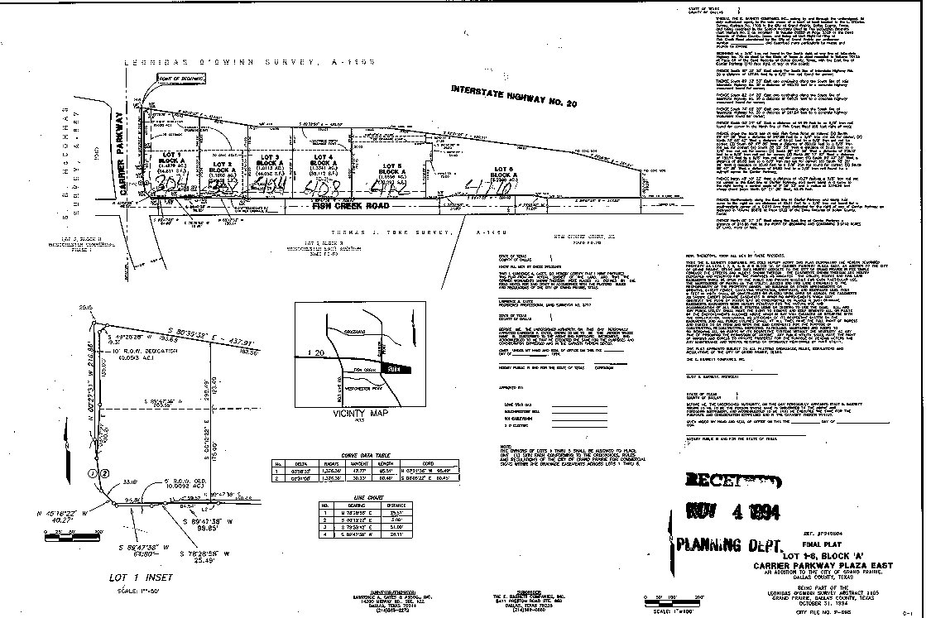
Types of Plats
Preliminary Plat (actually not required
by statute)
Final Plat
Minor Plat (4 or less lots)
Replat (Non-residential)
Replat (Residential)
Amending Plats
Vacating Plat
Administrative Plat

Slide 48
Approval Process
Submittal
Technical Review
Review by
Authority
Notes:
The approval process for subdivision plats includes three steps: Submittal, Technical Review, and Consideration by the Approving Authority. Let’s look at each step in the process in turn.

Slide 49
Approval Process - Submittal
Pre-submittal Conference (recommended)
Submittal Requirements - Statutory
Metes and bounds description
Land survey locating the subdivision
Dimensions of lots, streets, easements, public/common use areas
Acknowledgement of the owner
City may specify more requirements
Notes:
The pre-submittal conference begins the submittal process. The owner or owner’s representative meets with the appropriate city staff to discuss the proposed subdivision and review the submittal requirements. Keep in mind that meeting with the applicant will “vest” the project unless some type of waiver is agreed to
Statutory requirements include a meets and bounds description of the subdivision.
A land survey by a licensed surveyor must locate the subdivision with respect to a corner of the survey of which it is a part.
The plat must state the dimensions of the subdivision and each street, alley, or other part to be dedicated to public use or for the use of purchasers.
The plat submittal must contain an acknowledgement of the owner in the manner required for the acknowledgement of deeds.
Municipal requirements may be added to those required by statute.
Municipalities my provide additional requirements such as dedication provisions for public rights-of-way, easements, elevations for property located in floodplain, and other requirements.

Slide 50
Approval Process - Technical Review
Subdivision Plat Review Committee
City Departments
Engineering, City Services, Police, Fire,
Economic Development, GIS, etc.
Utility Companies
Committee meets to examine all code issues prior to consideration by approving authority
Notes:
The second step in the approval process is the technical review.
Many communities use a committee made up of representatives of various city departments including planning, engineering, transportation, fire, and others, and including outside utility companies.
Copies of the plat submittal are distributed to committee members for review prior to the committee meeting.
The committee meets to examine all code issues regarding the submitted plat and to resolve these where possible prior to consideration by the approving authority.

Slide 51
Approval Process: Review by Authority
Approving authority is the City Council
May delegate approval to Planning Commission
May allow staff administrative approval of certain minor plats, replats, amending plats
Must act on a plat within 30 days after it is filed, otherwise plat is considered approved
Note that the term “considered filed” needs to be defined specifically– is it when plat is submitted? Fees paid? Deemed complete?
Notes:
The approving authority shall act on a plat within 30 days after the date the plat is filed.
The plat is considered approved unless it is disapproved within the 30 days.
When is a plat considered filed? The date when the plat is considered filed must be defined in the subdivision ordinance.

Slide 52
When is a plat considered filed?
Generally:
The application is complete when the requirements are met.
City has 10 days to determine if plat application is complete
If not then a letter must be sent to applicant who then 45 days to submit missing information
Date Application is complete = file date
Application/vesting ceases if missing information not corrected w/in 45 days

Slide 53
Standards for Approval
Must approve plat if it conforms to:
The general plan of municipality;
The general plan for the extension of infrastructure;
The requirement to file a bond (if required);
All other technical requirements
Limited flexibility in plat approval
Notes:
The approval process must consider the established standards for plat approval that are contained in the subdivision ordinance.
The approving authority must approve a plat if it meets the applicable technical standards.
The approving authority has limited flexibility in reviewing a plat for approval. It is not a discretionary process, the approving authority is obligated to approve a plat is standards are met.
Subdivision plat approval is different than zoning approval.
A zoning is a legislative process to amend the zoning ordinance. The city is not obligated not obligated to approve a rezoning or zoning change request.
Plat approval is a technical review based on development standards. The city is obligated to approve a plat if the standards are met.

Slide 54
Replatting
Like a plat, the City must approve a replat that meets all ordinance requirements.
Residential replats require a public hearing with:
Notice in newspaper & mailed to owners w/in original subdivision & w/in 200 ft
Notices generally at least 15 days prior to hearing
Supermajority vote approval (3/4) required if owners of 20% of land area notified protest in writing.

Slide 55
Typical Components of a Subdivision Ordinance
Plat Approval Procedures
General layout of the Document
Minimum Design Standards
Conformance with zoning district regulations
Required Public Improvements/Funding
Dedication Requirements (or Fee in Lieu of Dedication)
Right-of-way /Easement Requirements
Plat Review Procedures and Fees
Consistency with Comprehensive Plan
Related Technical Documents
Notes:
Components of a typical Texas city subdivision ordinance include:
Procedures for obtaining approval of a plat
Minimum design standards for laying out blocks, lots, streets and other physical components.
A list of improvements (streets, sidewalks, water and sewer lines, etc.) required to be installed.
Requirements and procedures for dedicating land for open space or other public purposes, or for the payment of fees in lieu of dedication.
Requirements and procedures for dedicating rights of way and for granting easements.
Procedures for plat review and payment of fees.
Description of the method for financing public improvements, specifying which costs are to be borne by the developer and which, if any, are to be shared by the city.
A requirement that the design and other aspects of a new subdivision must be consistent with the City’s Comprehensive Plan

Slide 56
Subdivision Ordinance Related Technical Documents
Subdivision Ordinance specifically should refer to and requires compliance
Design Standards for Construction
Tables of design standards
Typical drawings of construction
Drainage Manual
Application, forms, fee schedule
Notes:
Many cities have separate documents for their technical drawings and standards. This keeps the ordinance simpler and allows the technical documents to be updated more frequently as building and construction techniques change.

Slide 57
“Vesting” Statute - Plats
Actually a “right to complete” statute
Triggered by utility, permit or plat application (sometimes even concept plan)
Have 2 years from permit date and 5 years once project is started
If “no progress” then an expiration date is critical
Court cases held documents w/o expiration date may still be vested
Ordinance should have automatic expiration date

Slide 58
Development Exactions
§212.904 Texas Local Govt. Code (Rough Proportionality)
Codifies Nollan/Dolan and Flower Mound Cases
If city requires developer to pay portion of infrastructure costs as condition of plat approval, developer’s portion of cost must be “roughly proportionate” or consistent with only the impact of proposed development
As estimated by city’s engineer

Slide 59
PROPORTIONALITY
15 foot ROW
dedication
50 acre tract
(1 single family residence)
27 foot concrete
street

Slide 60
15 foot ROW
dedication
50 acre tract
(100 single family lots – 0.5 unit/acre)
27 foot concrete
street

Slide 61
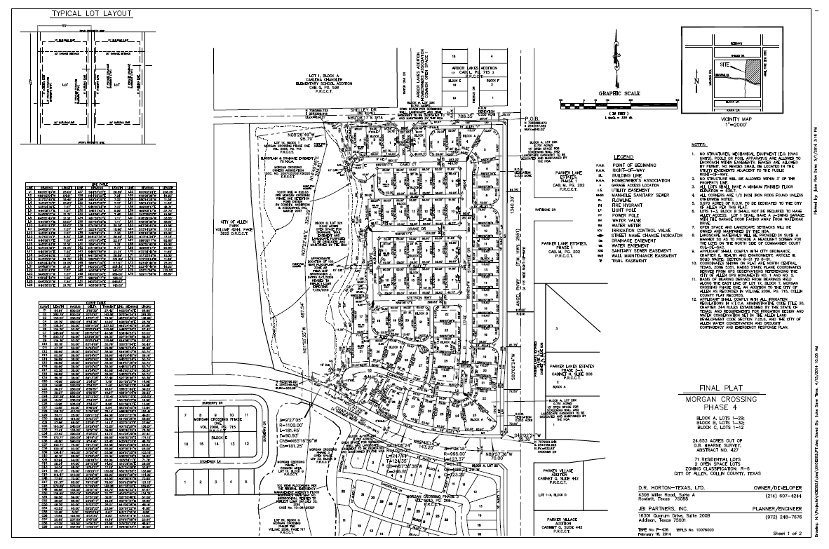
Components of a Plat
Notes:
Title Block
Proposed name of subdivision including phase, addition, or section
Legal description of property
Total acreage
Number of lots, blocks and reserves
Person or firm who prepared the plat, address
Owner’s name and address
Date that the plat was prepared
Zoning District
Purpose of replat, if applicable
Drawing orientation with north to the top of the drawing (or right if long and narrow)
North arrow
Scale (1”=100’) numerical and graphic scale (or appropriate scale)
Vicinity map in upper right corner showing the subdivision’s relationship with adjacent well known streets, railroads, water courses, etc., oriented with north to the top of the drawing and in the same direction as the detailed subdivision drawing
Plat boundary in heavy lines with measured bearings and distances tied to survey corners or intersections
abstract lines
survey lines
corporate boundaries, district boundaries
existing or proposed highways and streets
Location of existing buildings (buildings outlines to be removed prior to final plat submittal
Locations of recorded easements - dashed line with recording information
Proposed new easements - dashed line
Lines outside plat boundary should be dashed
location and size of all watercourses
100-year flood plain according to Federal Emergency Management Agency (FEMA) information
name and location of all adjoining subdivisions, unplatted land and property owners,
existing or proposed streets,
alleys,
railroads, easements, and
features that may influence the layout of development within 200 feet of the boundary
All zoning designations of the site and within 200 feet of the site, if applicable shall be clearly noted and complied with accordingly

Slide 62
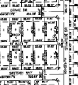
Lots
Block(s) number within boundary of plat
Lot number(s) on each lot = Sequential
Lot width and depth per zoning district
Lot width on radial lots
Reserve, tracts or parcel(s) identified by letter/number = Sequential
Lots and reserves with measured bearings and distances (final)

Slide 63
Streets
Check Major Street Plan for major thoroughfare and major collector. Alignments, dedications and future widenings.
Check existing street ROW widths
Check cul-de-sac radius - 50’ R for residential, 60’ R for commercial
Check intersections spacing (block length) between streets. Check minimum spacing of intersections along a major thoroughfare
When widening is required make sure that the dedication is measured with bearings and distances and square footage is provided. Include dedication to public statement on plat.

Slide 64
Streets continued
If one ROW width transitions to another width, add note to plat.
Street intersection off-sets
Maximum length of residential cul-de-sac
Verify reverse curves
Check the number of access points into the subdivision
At all intersections a visibility triangle must be provided. Add visibility triangle note

Slide 65
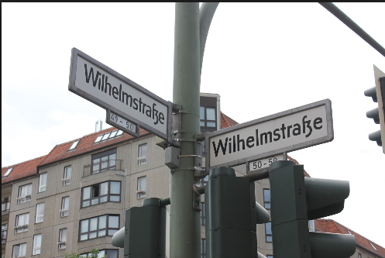
Street Names
Check street name for duplication and similarity
Check 911 list
Street names must end in suffix (Drive, Road, Lane, Street, Boulevard, etc.)
Check for street name breaks where street names change
Photo: Hero Fukutu

Slide 66
Even More….
Utility and Access Easements
Public utility easements shall conform to design manual
Other easements should the design requirements of the design manual
Fire Hydrants
All hydrants are within 600’ of each other.
All building meet 200’ hose lay from private street edge per design standards and Fire Department criteria.

Slide 67
Contact Letters
Water District(s)
County
School Board(s)
Utility Company
Post Office

Slide 68
Final Plat
Verify the exact location, grade, dimension, description, and name of all proposed streets, alleys, parks, other public areas, reservations, easements or other public rights-of-way, blocks, lots, and other sites or facilities within the subdivision, along with accurate dimensions, bearing or deflection angles and radial, area, central angels, degree of curvature, tangent distances, and length of all curves where appropriate
Global Positioning System (GPS) coordinates are recommended where applicable.
Location of all survey corners and permanent monuments

Slide 69
Final Plat continued
Certification, dedication and acknowledgement blocks of the owner, engineer, surveyor, Planning Commission Chair and Mayor, lien holder, fully signed, executed and appropriately sealed
A title page if the information is too large for a single sheet
General Plat Notes as appropriate
Corporations require two signatures, Limited Partnerships or Joint Ventures one
Owner’s signatures and lien holders notarized

Slide 70
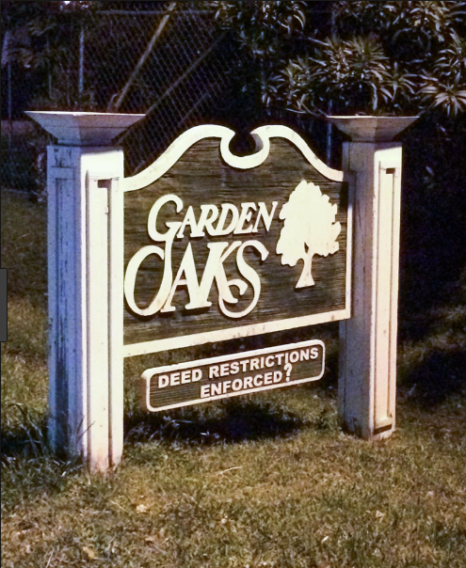
At Last!
Digital file
Tax Certificates
HOA/Deed Restrictions
Fees
As-Builts/Construction Documents
Photo: swamplot.com

Slide 71
Other Issues
Extraterritorial Jurisdiction
Most Cities extend their Subdivision Regulations into the ETJ
Gated Communities, Private Streets
Need to have specific requirements to handle eventual replacement
Impact Fees/Pro-Rata Charges
Fees that cover effect of development on existing city services
Park Dedication or Fees-in-lieu-of Land

Slide 72
Thank you! Questions and Discussion?

