Slide 1
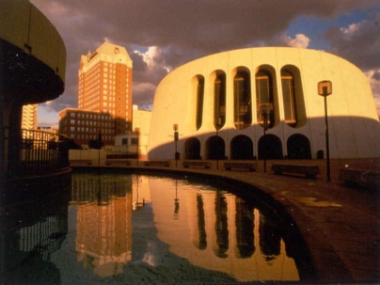
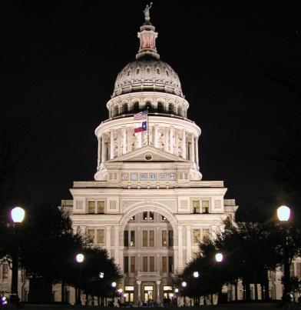
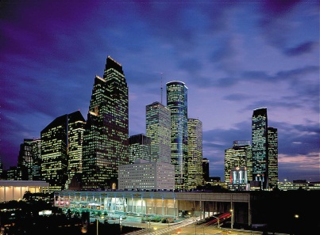
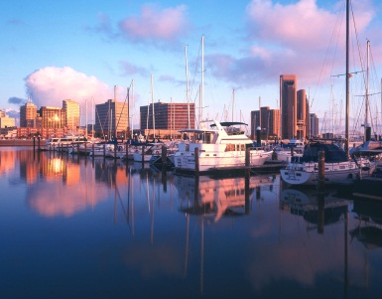
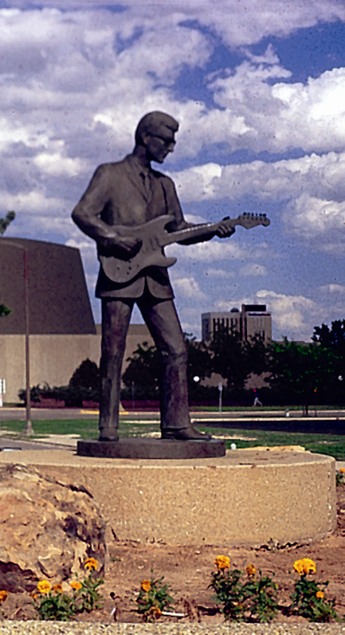
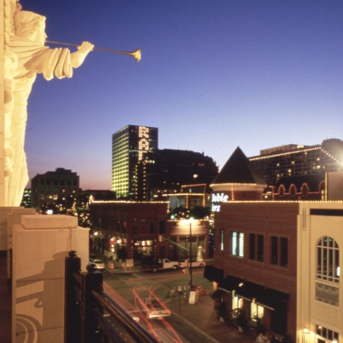
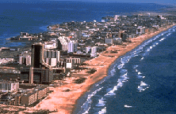
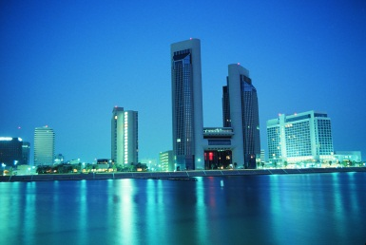
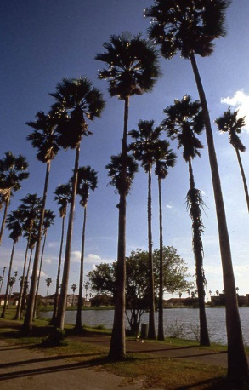
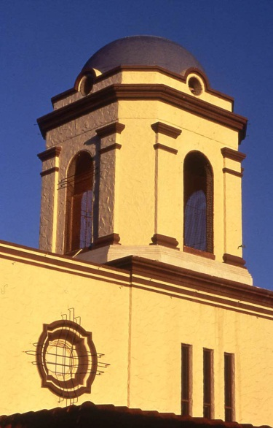
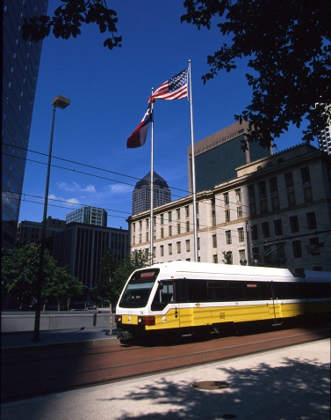
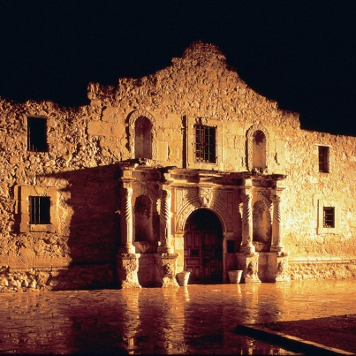

Slide 2
Basics of Planning and Development Review
A Historical Perspective on planning and development regulation
Speaker:
Craig Farmer, FAICP
Mike McManely, FAICP
2018 Elected & Appointed Officials Planning Workshop
Sponsored By
Texas Chapter of American Planning Association
Based on A Guide to Urban Planning in Texas Communities of the Texas Chapter of American Planning Association.

Slide 3
Why Planning is Important
National Survey (APA, 2000)
Likely voters want:
Professional planners in their community (81%)
Adequate schools and educational facilities (76%)
Availability of public services (74%)
Create and protect parks and recreation areas (67%)
Preserve farmland and open space (67%)
Protect wetlands and other natural areas (65%)
Create affordable housing options (64%)
Statewide Survey (TXAPA, 2002)
Likely voters want:
Important to have community planner (85%)
Protect open spaces, coastal areas and parkland (88%)
Provide incentives for affordable housing (85%)
Create transportation options like light rail, bus transit and bicycle trails (81%)
Support right of local communities to make decisions for private property (81%)
These are all planning issues!

Slide 4
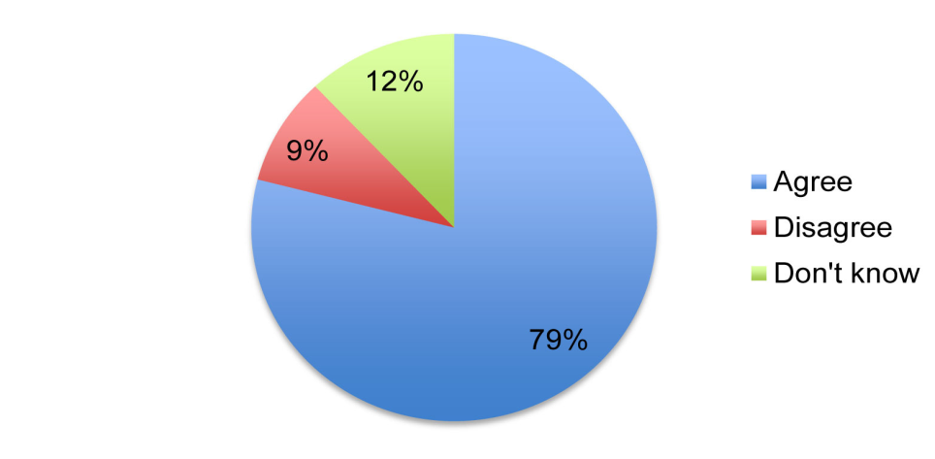
June 2012 National Survey QUESTION Generally, do you agree or disagree that your community could benefit from a community plan as defined as "Community planning is a process that seeks to engage all members of a community to create more prosperous, convenient, equitable, healthy and attractive places for present and future generations"? ANSWER 79% agree that their community could benefit from planning as defined 9% disagree (12% don’t know) 88% of Democrats agree 77% of Republicans agree 81% of Independents agree
Source: APA, 2012

Slide 5
QUESTION Some people believe their community needs planning, while others believe it should be left alone. Which comes closest to your belief? ANSWER 66% say planning is needed in my community 17% say planning is not needed (17% don’t know) 77% agree that “Communities that plan for the future are stronger and more resilient than those that don’t”
SEGMENT | SUB-SEGMENT | % PLANNING IS NEEDED
Political Affiliation | Democrat | 75%
 | Republican | 65%
 | Independent | 67%
Race/Ethnicity | White | 66%
 | African American | 69%
 | Hispanic | 67%
Type of Community | Urban | 73%
 | Suburban | 65%
 | Rural | 59%
 | Small Town | 67%
Source: APA, 2012

Slide 6
QUESTION Now please think about an "ideal community" for you to live in and tell us whether each of the following would be a high, medium, or low priority for you.
FACTORS IN AN IDEAL COMMUNITY | % HIGH PRIORITY
Locally owned businesses nearby | 55%
Being able to stay in the same neighborhood while aging | 54%
Availability of sidewalks | 53%
Energy-efficient homes | 52%
Availability of transit | 50%
Neighborhood parks | 49%
Mix of housing price ranges | 43%
A place that attracts young professionals to live | 42%
A place with lots of things for kids to do | 41%
Mix of housing choices | 41%
Schools within walking distance | 37%
Jobs within walking distance | 33%
Unique character and/or culture | 32%
Restaurants within walking distance | 31%
Availability of bike lanes | 25%
A place with lots of young children | 17%
Houses being generally the same size | 6%
Source: APA, 2012

Slide 7
Recent Attacks on Planning
Private Property Rights
Fifth and 14th amendments to US Constitution
Texas Private Real Property Protection Act
Agenda 21
Report from 1992 UN Conference on Environment and Development. No legally-binding requirements. Not a UN conspiracy.
All planning is not related to Agenda 21. Comprehensive planning, sustainable development, smart growth, growth management, and pedestrian-oriented development are not code words for Agenda 21.
Planning as a result of Agenda 21 does not prohibit single family homes, car ownership, family farms, or private property rights

Slide 8
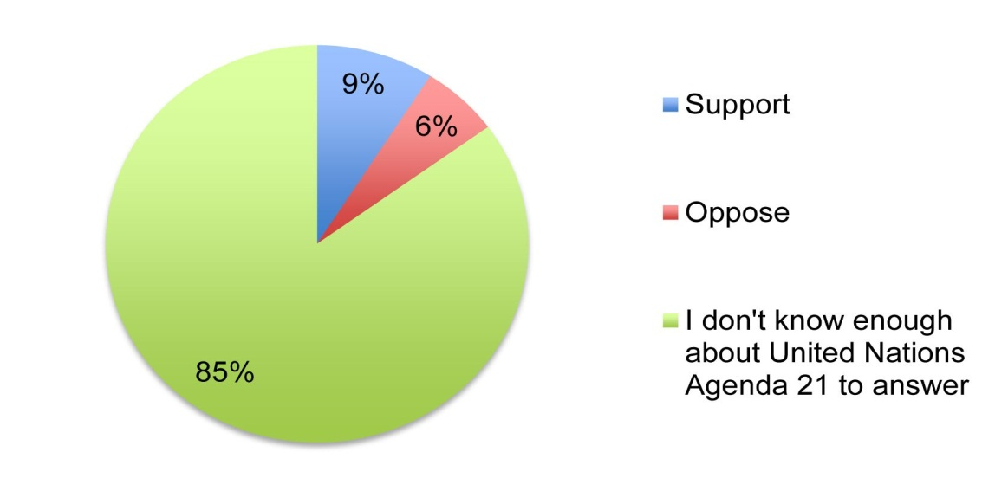
QUESTION Do you support or oppose United Nations Agenda 21?
Table 10: Support for United Nations Agenda 21 (by sub-segment)
SEGMENT | SUB-SEGMENT | % SUPPORT | % OPPOSE
Political Affiliation | Democrat | 8% | 2%
 | Republican | 3% | 14%
 | Independent | 3% | 11%
Race/Ethnicity | White | 3% | 11%
 | African American | 9% | 7%
 | Hispanic | 14% | 7%
Type of Community | Urban | 11% | 9%
 | Suburban | 5% | 10%
 | Rural | 3% | 11%
 | Small Town | 3% | 7%
Source: APA, 2012

Slide 9
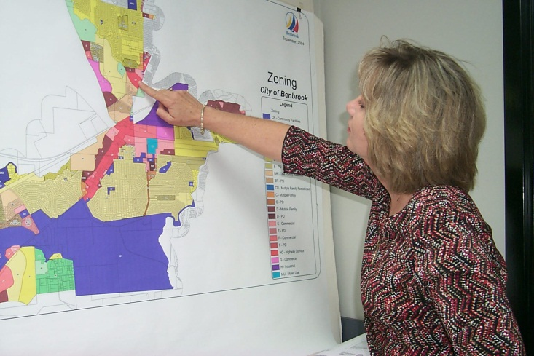
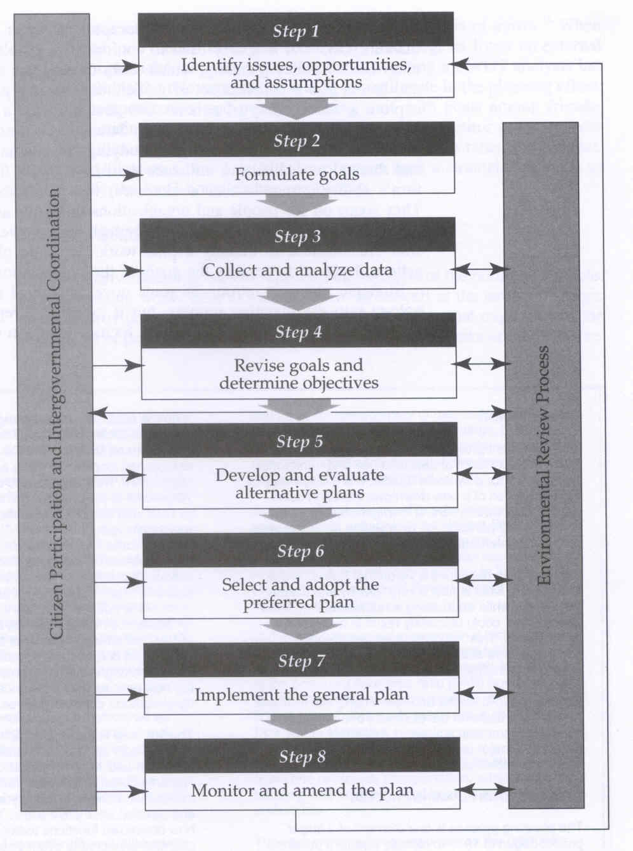
What is Planning?
Planning as a design activity (maps etc.)
Planning as a decision-making process (selection from alternatives)

Slide 10
Development of American City Planning
Pre-1900s
Modern Physical Planning Period (1893-1945)
Rational Comprehensive Planning Period (1945-1960s)
Post-Modern Planning Period (1960s to present)

Slide 11
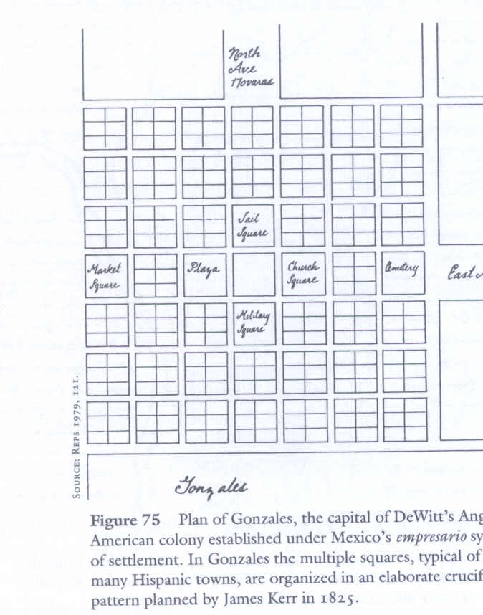
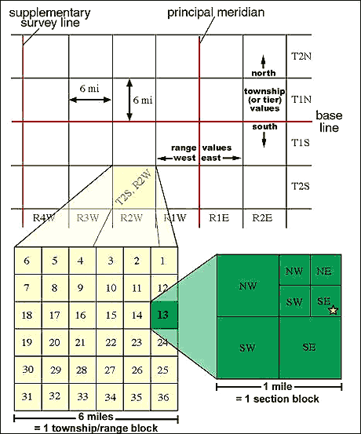
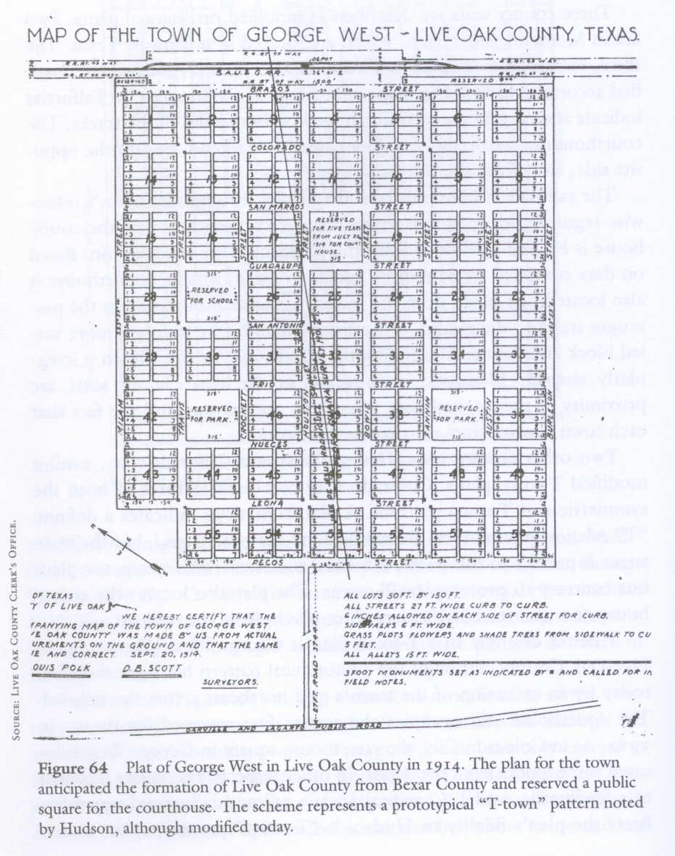
Brief History of Planning in America
1573 – First Law of the Indies for Spanish settlements
1638 – Nine Square Plan for New Haven
1785 – Northwest Ordinance of 1787 (establishes one-mile grid and sections)
19th Century – Railroad town sites

Slide 12
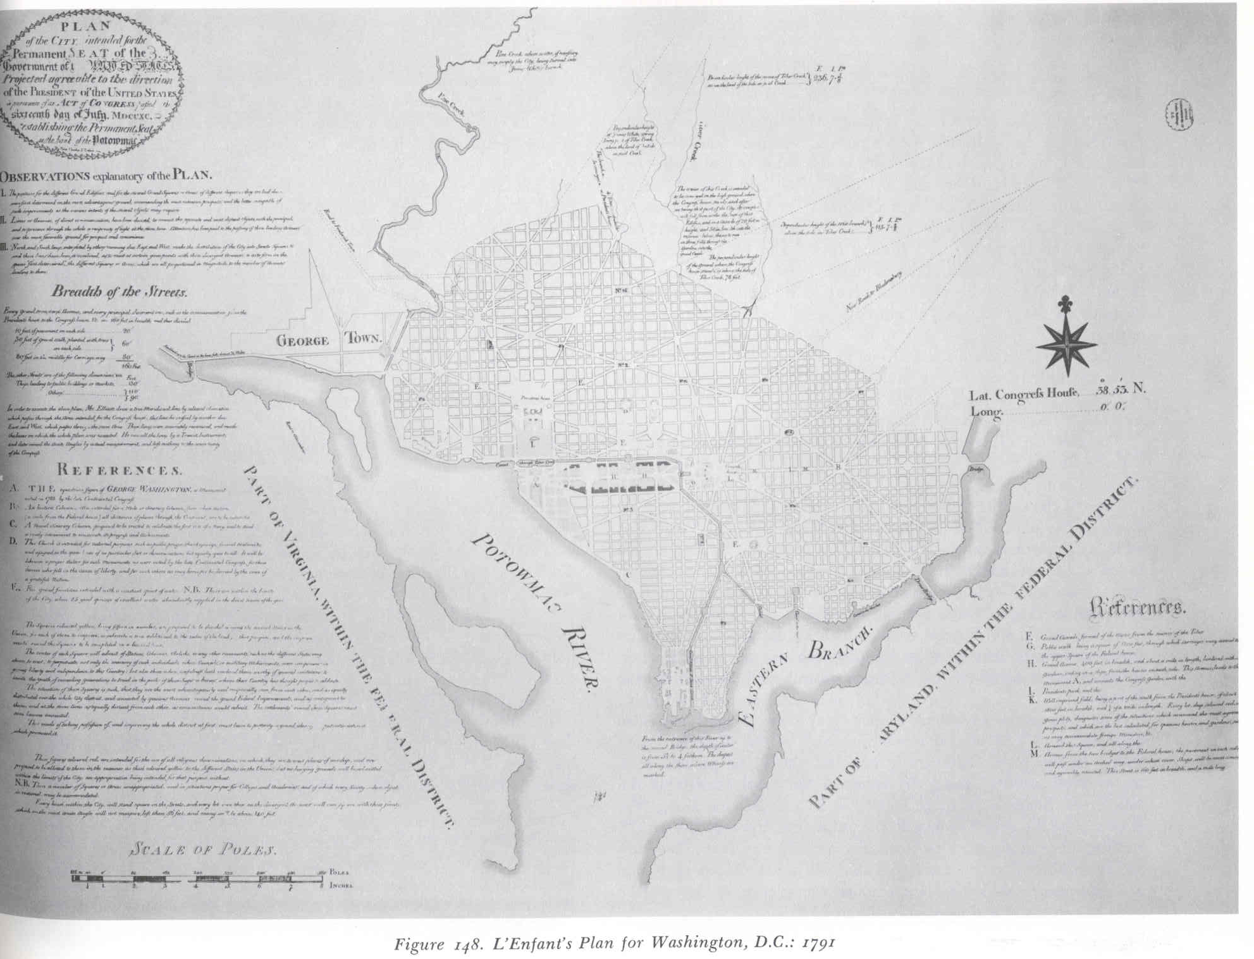
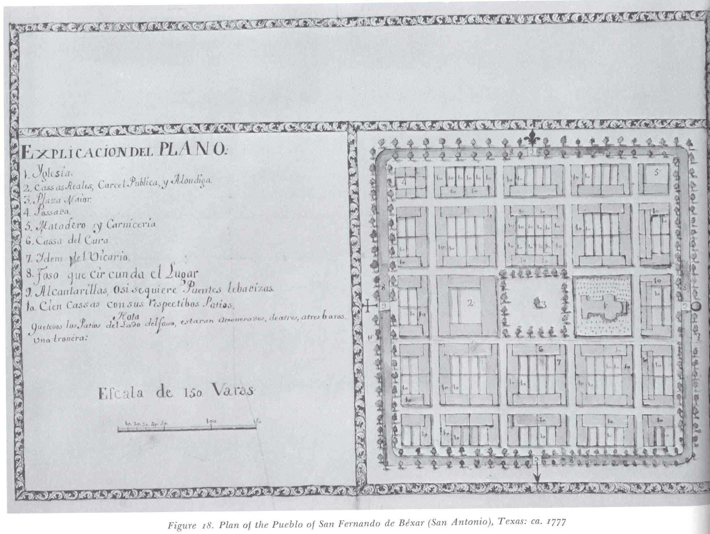
Pre-20th Century American Planning
San Antonio 1777
Washington DC, 1791

Slide 13
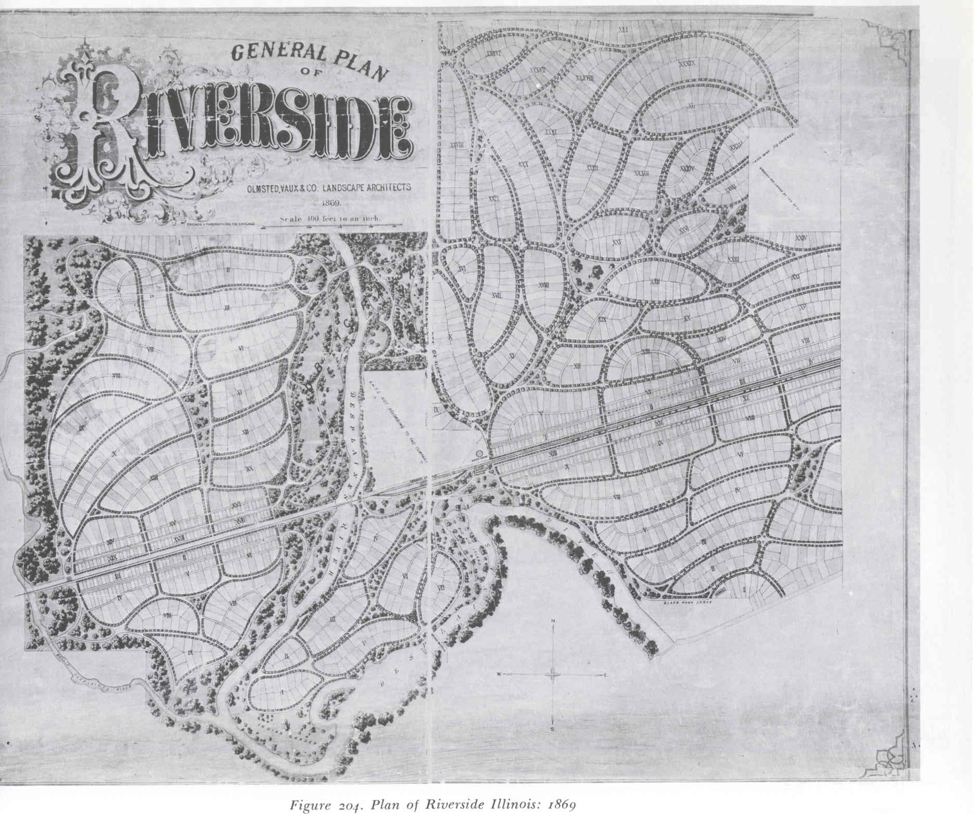
Brief History of Planning
1857 – Frederick Law Olmstead and Calvert Vaux plan for Central Park, NY
1868 – Olmstead and Vaux plan for Riverside, Illinois

Slide 14
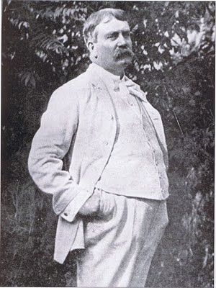
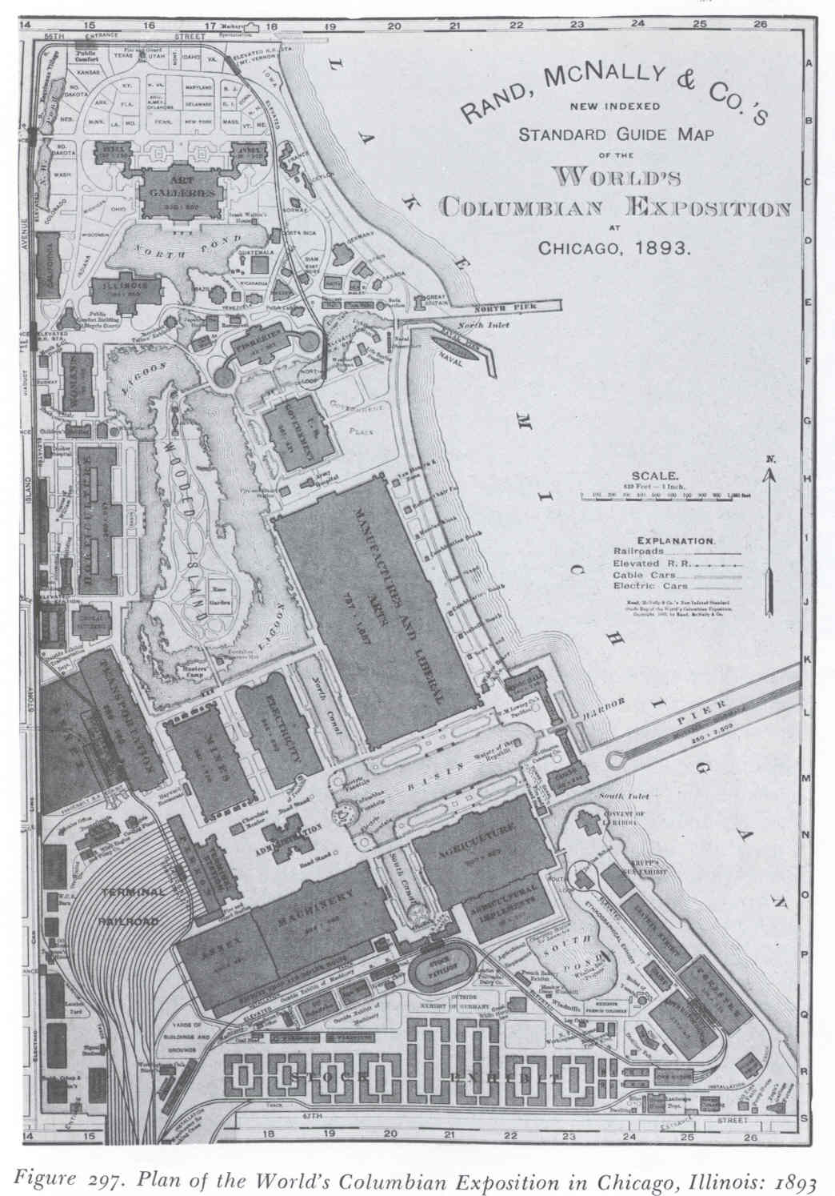
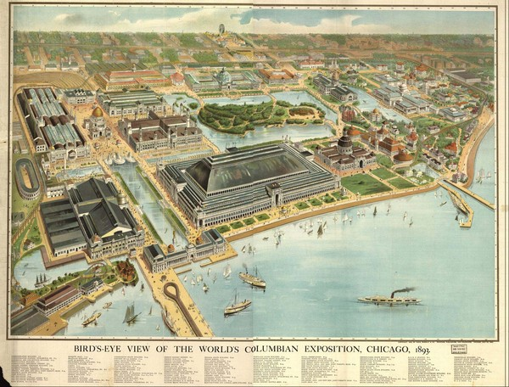
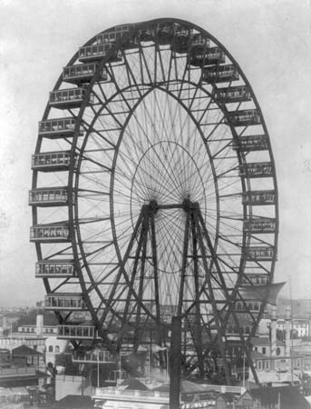
Brief History of Planning
1893 – World’s Columbian Exposition promotes Modern Physical Planning and City Beautiful Movement
(Daniel Burnham)

Slide 15
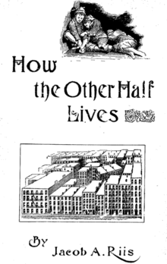
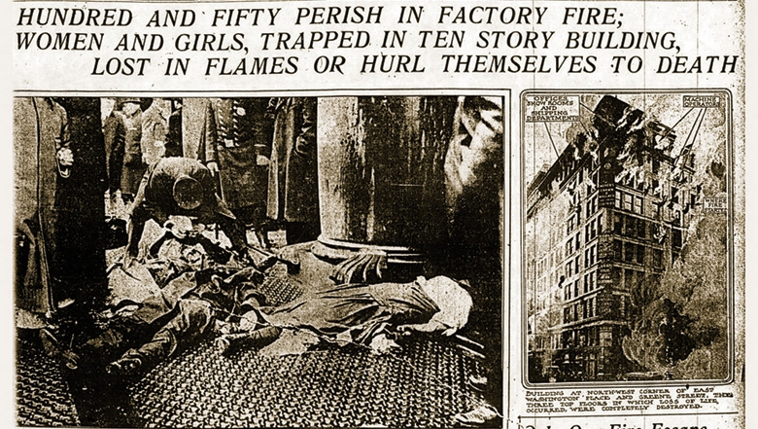
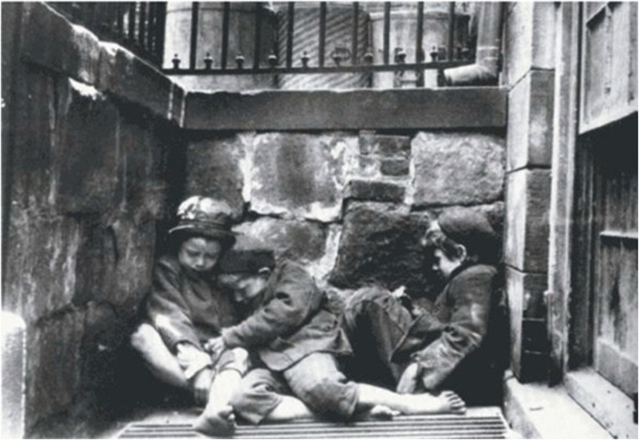
Modern Physical Planning
Process of graphically designing the future development of the City. Modernism espoused that social ills could be mitigated through proper design.
Architecture-Public Health-Social Work

Slide 16
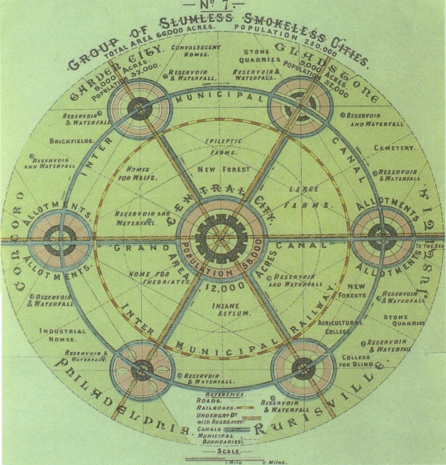
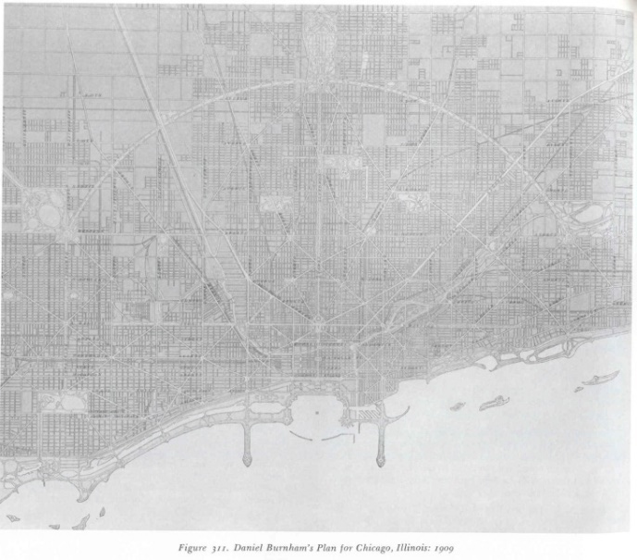
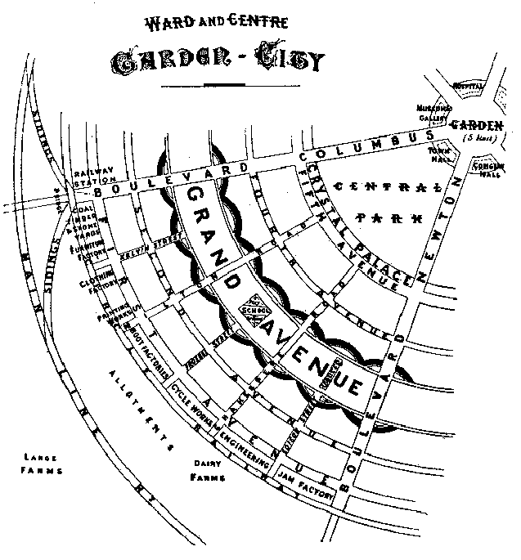
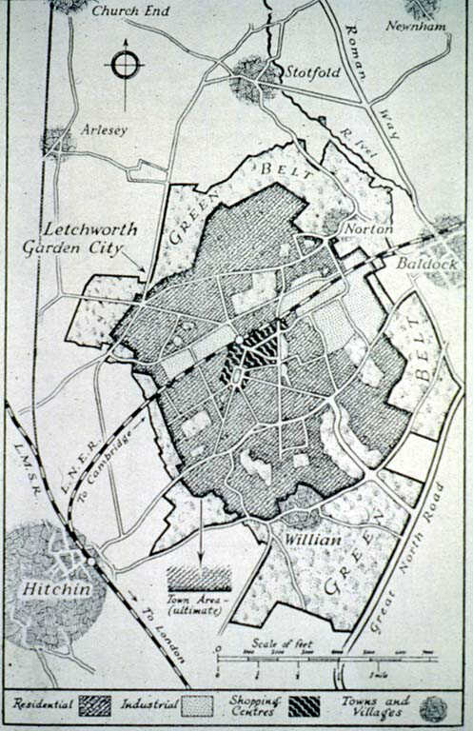
Modern Physical Planning Period
1898 – 1st city planning conference, New York
1901 New York Tenement House Law
1903 – Garden Cities of Tomorrow
Ebenezer Howard, Letchworth, England
1907 - Hartford Commission
1909 - Burnham Plan of Chicago
1909 – 1st National Conference on City Planning

Slide 17
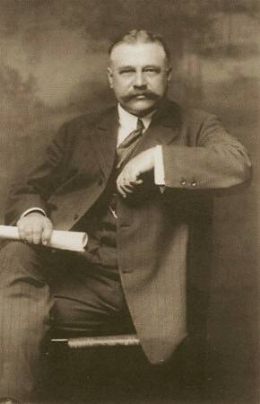
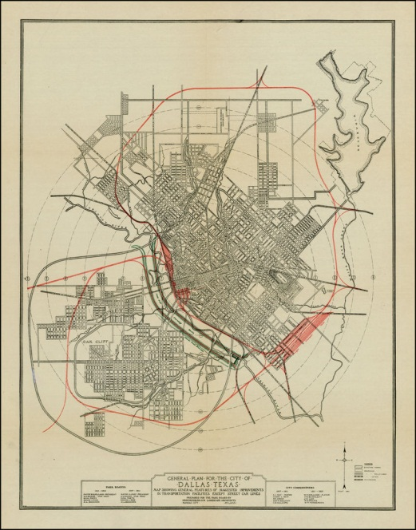
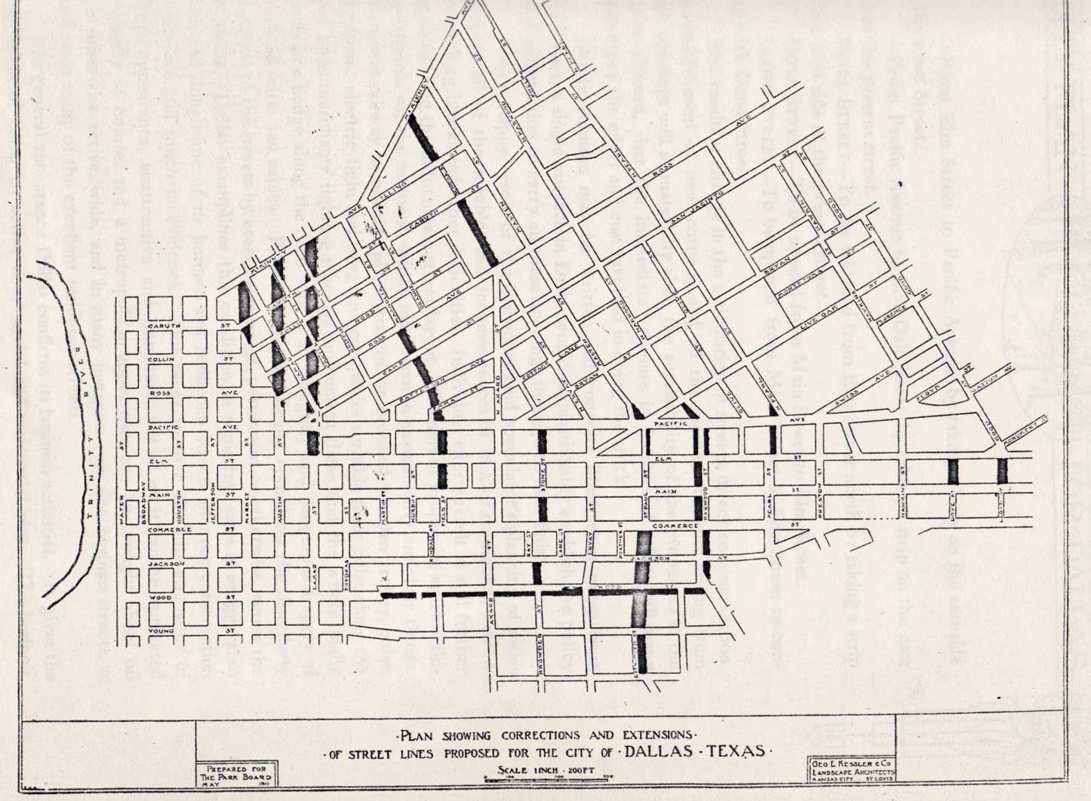
Modern Physical Planning Period
1911 – Kessler Plan for Dallas
1911 – Frederick Taylor’s Principles of Scientific Management, City Efficient Movement

Slide 18
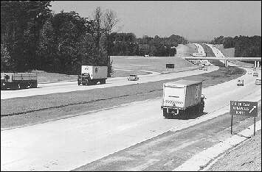
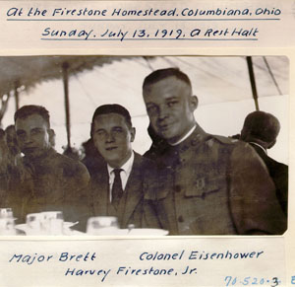
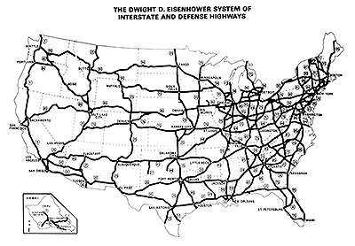
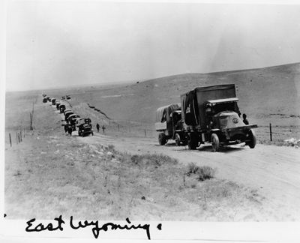
Modern Physical Planning
1916 – Bankhead Highway
1919 – Transcontinental convoy
1956 – Interstate Highway System

Slide 19
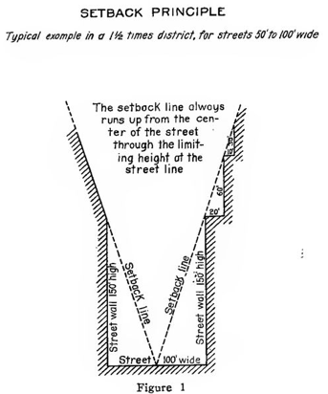
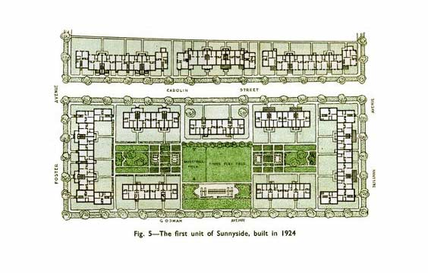
Modern Physical Planning Period
1916 - New York City Zoning Code
1917 – American City Planning Institute
1922 – Standard Zoning Enabling Act
1924 – Sunnyside Gardens
Clarence Stein and Henry Wright
1926 – Ambler Realty v. Euclid

Slide 20
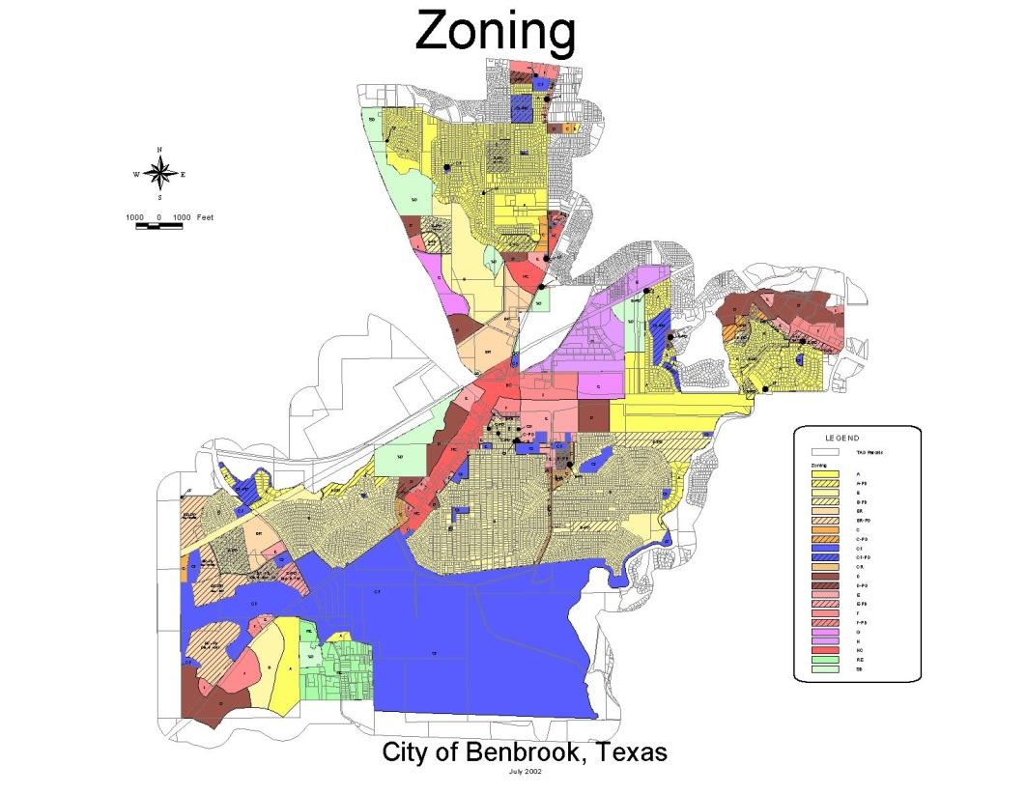
What is Zoning?
Zoning regulations govern the use of land, and the location, size and height of buildings. Zoning divides a jurisdiction into multiple districts, with each district containing a distinct set of regulations that are uniformly applied to all property within the district. Zoning ordinances consist of a text specifying the regulations and a map defining the location of the districts.

Slide 21
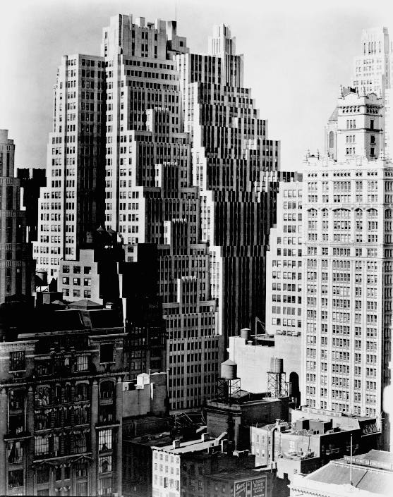
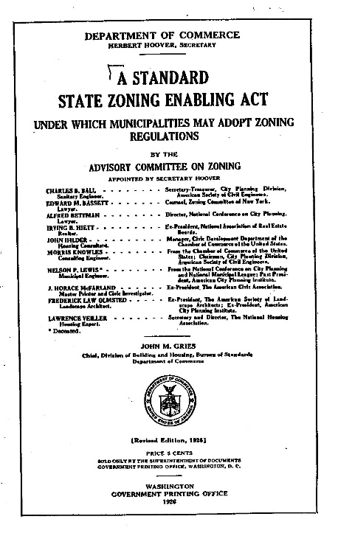
Zoning
History of Zoning Authority in U.S
Early zoning ordinances (Washington, DC, Los Angeles, San Francisco, Baltimore, New York City)
New York City zoning ordinance (1916)
Standard Zoning Enabling Act (1922)
City of Euclid v. Amber Realty (1926)
Police power under Constitution
Limitations on Zoning
Federal (5th and 14th Amendments)
Procedural due process
Substantive due process (regulatory takings)
State
Taking statute (applies to State and County, not City)
Vesting Stature (LGC 245)
Zoning Compensation bills

Slide 22
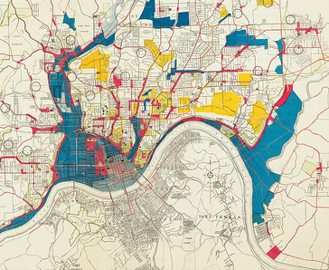
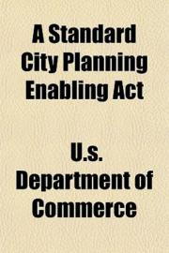
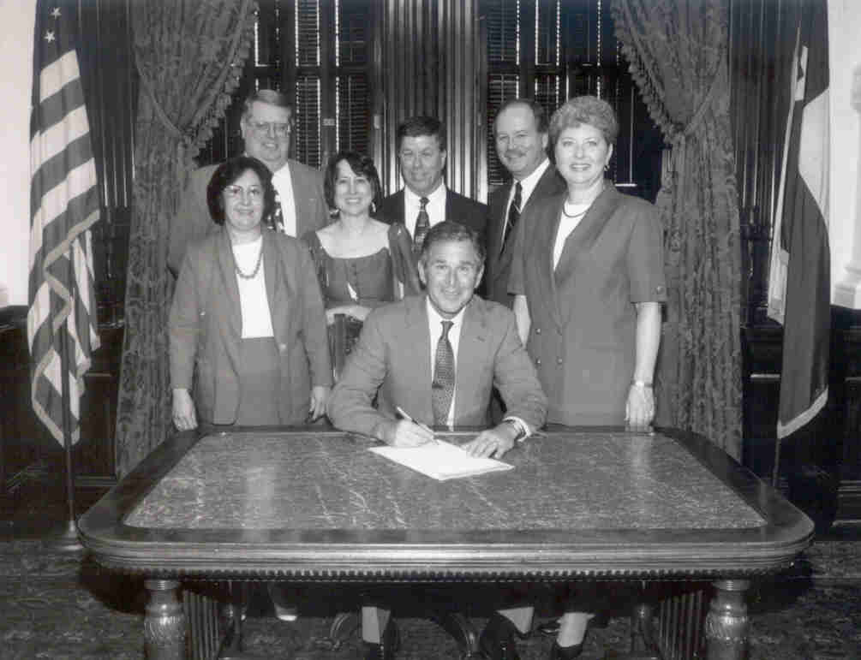
Modern Physical Planning Period
1925 – Cincinnati Comprehensive Plan
1928 – Standard Planning Enabling Act
1954 – General Plans funded under Sec. 701 of Housing Act
1999 – George W. Bush signs Texas comprehensive planning statute

Slide 23
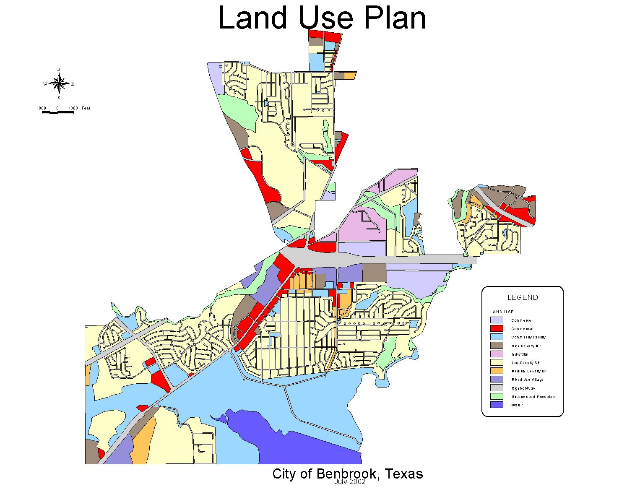
Comprehensive Planning
Comprehensive Planning looks at more than just the physical design of the community, but also looks the inter-relationship of land use, infrastructure, community facilities, and other community programs.

Slide 24
Comprehensive Planning Statute
Chapter 213 of Local Government Code
Purposes
Promote sound development
Promote public health, safety and welfare
Adoption by ordinance
After review by Planning Commission
After public hearing
Conformity Requirements
Zoning disclaimer “A comprehensive plan shall not constitute zoning regulations or establish zoning district boundaries”

Slide 25
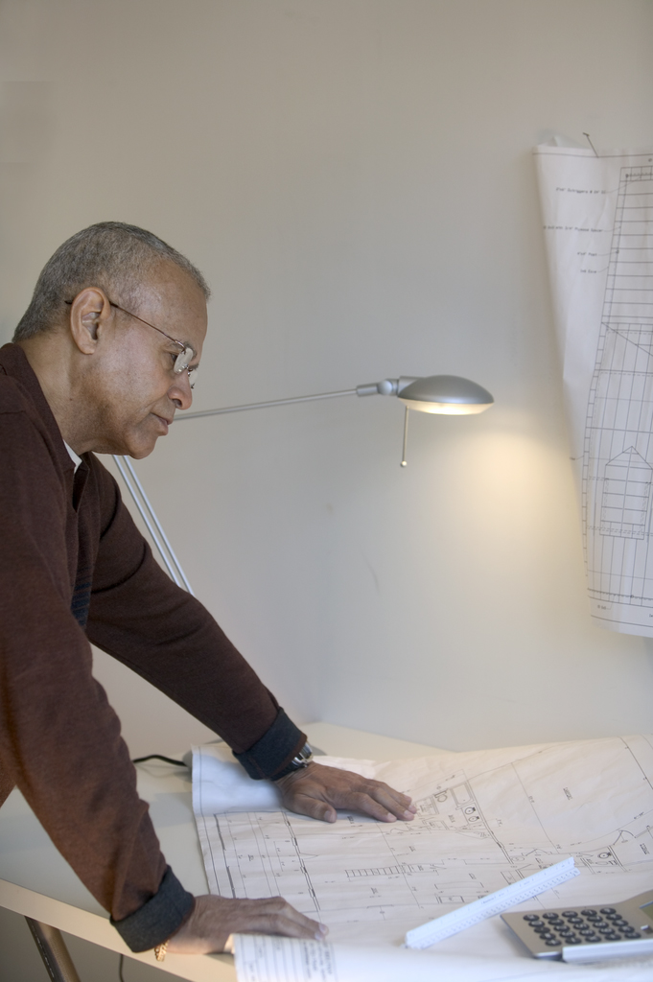
Reviewing Comprehensive Plan Amendments
Administrative review
Have they given you everything that you require to make decision?
Planning Review
Look at the big picture
Does the proposed change meet your planning goals?

Slide 26
Land Use Plan Amendments
Is this the best ultimate land use for this area, rather than the existing Land Use Plan designation?
Be careful not to react to cyclical market demands. Change when change is the right thing to do in the long term.
Are there any environmental constraints? (e.g. floodplains, noise, landfill issues)
Does the proposed land use make sense for that location? (land use conflicts, relationship to other uses, access, utility service, etc.)

Slide 27
Thoroughfare Plan Amendments
Most requests will be to delete, relocate, or reduce size of streets
Is circulation maintained?
Street connectivity
Will a change in Thoroughfare Plan and/or Land Use Plan affect traffic volumes?
Be careful to avoid choosing short-term gains over long-term benefits.

Slide 28
Zoning
Relationship to Comprehensive Plan:
Which comes first, planning or zoning?
Relationship to Subdivision Regulation
Zoning regulates use, lot size, setbacks and heights
Plats regulate street and lot layout, infrastructure, etc.

Slide 29
Subdivision Regulations
Subdivision regulations govern the division of land into two or more parts. The regulations specify the standards for drawing and recording a plat, and requirements for public improvements necessary to make the property suitable for development.

Slide 30
Modern Physical Planning Period
1928-30 - Radburn, New Jersey
1929 - Regional Plan for New York John Nolen
1929 – Neighborhood Unit Concept Clarence Perry

Slide 31
Modern Physical Planning Period
1934 - Housing Act of 1934
Federal Housing Administration
1935 - Resettlement Administration
Greenbelt cities
1941 – Local Planning Administration, by Ladislas Segoe, 1st Green Book

Slide 32
The Rational Planning Process 1940s
Existing
Conditions
Continuing
Planning
Visioning
The Rational Planning Process is a decision-making process of evaluating alternatives.
Strategies
&
Actions
CITIZEN
INVOLVEMENT
Goals
&
Objectives
Plans &
Policies
Needs
Analysis
Alternative
Scenarios

Slide 33
Rational Comprehensive Planning Period
1947 – Levittown
1949 - Housing Act of 1949
Urban renewal
1954 - Housing Act of 1954
Section 701 planning funds
1956 – Federal Aid Highway Act

Slide 34
Rational Comprehensive Planning Period
1957 – Gruen Plan for Fort Worth
1961 – Statewide Zoning, Hawaii
1964 – Columbia, Maryland
1965 - Reston, Virginia

Slide 35
Strategic Planning – 1960s
Focused short-term planning effort identifies:
Mission of organization
Internal strengths and weaknesses
External opportunities and threats
Future possible scenarios over 3 to 5 years
Specific goals and objectives to achieve mission. Objectives should be “SMART”
Specific
Measurable
Attainable
Results-based
Time bound

Slide 36
versus
Comprehensive Planning
Strategic Planning
Long range, 10-20 yrs
Comprehensive (geographical)
Comprehensive (physical, economic, social)
Value oriented
A policy guide
Designates future land use
Implementation tools (regulations, funding)
Continuous
Mission directed
Short range, 1- 5 yrs
Realistically targeted
Market oriented
Action oriented
Identifies strengths, weaknesses, opportunities, and threats

Slide 37
Post-Modernism Period
1960s – social and environmental movements
1960 – Image of the City, Kevin Lynch
1961 – Death and Life of Great American Cities, Jane Jacobs
1962 – Advocacy Planning, Paul Davidoff
1969 – Design with Nature, Ian McHarg

Slide 38
Post-Modernism Period
1969 – National Environmental Policy Act
1972 – Oscar Newman’s Defensible Space
1974 Housing and Community Development Act, CDBG
1984 – Seaside, Florida, New Urbanism, Andres Duany and Elizabeth Plater-Zyberk

Slide 39
Crime Prevention Through Environmental Design (CPTED) Jane Jacobs and Oscar Newman influences
Natural surveillance
Eyes on the street
Avoid blind spots
Natural access control
Delineate public and private space
Clearly defined entrances
Territorial behavior
Sense of ownership
Crime Triangle
An Offender
Crime
An Opportunity
A Victim
All three variables must be present. Eliminate at least one and the crime can be prevented.

Slide 40
New Urbanism
Reject Euclidean Zoning- Use Form-based Design Codes
Mixed uses
Regulate form rather than use
Human-scale design
Respect street grid, connectivity
Congress for New Urbanism
Design based on scale
Metropolitan, City and Town goals
Block, street and Building goals
AKA Traditional Neighborhood Design - New urbanism at neighborhood scale
Source: DPZ and Associates

Slide 41
Form-based Codes -The Transect
Form-Based Regulating Plans

Slide 42
Regulating Plans

Slide 43
Technology
Visioning Software
Geographic Information Systems – 1990s
Intelligent maps (location and tabular)
ArcGIS (ESRI), MapInfo, others

Slide 44
Recent Trends in Planning
1980s - Growth Management
Hawaii, Oregon, Florida, Georgia
1990s - Smart Growth, Sustainable Development
2000 - Disaster Mitigation Act
2000s – Traffic Calming, Context-sensitive Solutions

Slide 45
Smart Growth
Scale: Regional vs. Local
Features of Smart Growth:
Compact development
Mixed uses
Mobility choice (pedestrian orientation)
Open space preservation
Infill development
The Domain, Austin

Slide 46
Regional vs. Local Scale Smart Growth
Regional Programs include growth management that directs the timing and location of development
Urban growth boundaries
Adequate public facilities ordinances
Cluster or conservation developments
Transfer of development rights

Slide 47
Regional vs. Local Scale Smart Growth
Local Programs are projects that incorporate principles of smart growth
Mixed uses
Pedestrian orientation
Transportation alternatives
Preservation of public open space
Compact development
Maximum density vs. minimum density
Set-back lines vs. build-to lines

Slide 48
Smart Growth Programs in Texas
Austin
Smart Growth Matrix
Envision Central Texas
Flower Mound
North Central Texas Council of Governments
Center for Development Excellence
Vision North Texas
Smart Growth Projects Examples
Addison Circle
Southlake Town Center
Plano Transit Village
The Domain - Austin

Slide 49
Sustainable Development
Intergenerational and intragenerational equity
Protecting and living within the natural carrying capacity of the natural environment
Minimization of natural resource use
Satisfaction of basic human needs
Sustainable Development versus Consumptive Development
Three “E”s of sustainability
Economy
Environment
Equity

Slide 50
Sustainable Development – Better Site Planning

Slide 51
Cluster Development

Slide 52
Sustainable Development – Green Building
LEED-Leadership in Energy &
Environmental Design
U.S. Green Building Council
Rating System based on
Sustainable sites
Water Efficiency
Energy and Atmosphere
Materials & Resources
Indoor Environmental Quality
Innovation & Design Process
LEED-ND

Slide 53
Disaster Mitigation Planning

Slide 54
Traffic Calming Context-Sensitive Design

Slide 55
Traffic Calming Context-Sensitive Design

Slide 56
Capital Improvements Planning
A plan for investment of public funds in public infrastructure. It identifies construction projects (typically streets, drainage, water, sewer, parks, and public buildings) that will be built over next one year, five years, 10 years & beyond. It also guides budgeting of funds for capital expenses, debt service, and bonding capacity.

Slide 57
Questions?

Slide 58
Important Acronyms
AICP – Any Idiot Can Plan
B4 – Big Bland Beige Box
BANANA – Build Absolutely Nothing Anywhere Near Anything
CAVE People – Citizens Against Virtually Anything
DBTD – Death By a Thousand Days
DUDE – Developer Under Delusions of Entitlement
LULU – Locally Unwanted Land Use
NIMBY – Not In My Back Yard
NIMFYE – Not In My Front Yard Either
NOTE – Not Over There Either
NIMTOO – Not In My Term Of Office
NITL – Not In This Lifetime
NOT – None Of That
TOAD – Temporary Obsolete Abandoned or Derelict
WIIFM – What’s In It For Me?

Slide 59
Important Terms
Bungalow Bill – tract house architect
Comprehensive Flan – bland, custard-like filling in many comprehensive plans
Custard Development – bland clustered development
Dejavenue – impression of having seen the same street before
Disneyfication – architectural fad on a community scale
Generica- stores and strip malls you can see in any town in America
Landscraper – landscape architect (also Blandscape Architect – a minimalist landscape architect)
Litter on a Stick - billboard
McPlace – standardized sense of place
Pacebo – a place that has the appearance, but none of the value of a real place
Privatopia – gated community run by homeowners association
Ranchburger – one-story, generic southwestern tract house

Slide 60
Important Terms cont.
Scents of place – odors, smells, aromas and fragrances associated with a place
Sense of Immunity – mistaken belief that a regulation doesn’t apply
Snout House – home dominated by garage door
Starter Castle – also knows as a McMansion, Big Hair House and Tract Mansion
Powerpoint Poisoning – nauseous state of mind and body induced by presentations

